Slide 1


SAP UI5 & FIORI with OData TRAINING
Anubhav Oberoy
Day – 20

Slide 2
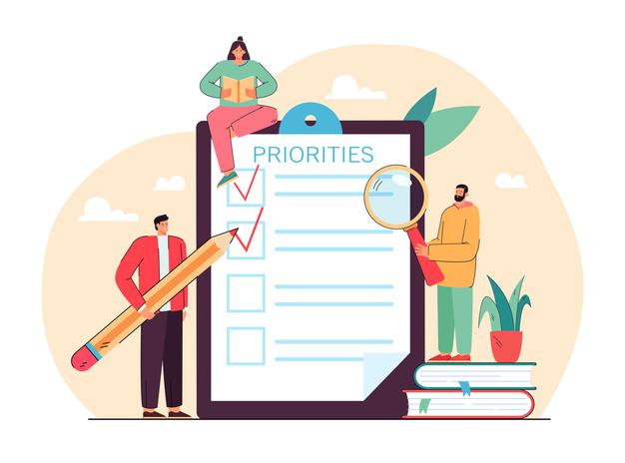
Agenda – Day 20
Standard Applications in Fiori
Activating standard fiori app using task list
Key User Extensions
Open Questions & Test

Slide 3
Title
Content

Slide 4
Title
Content

Slide 5
Title
Content

Slide 6

End of Day

Slide 7

Questions

Slide 8

Anubhav Oberoy

Slide 9


We’re committed to empower you to be
Most Desirable Resource
through powerful training solutions.
We build the workforce of the future.
250+
Corporate Clients
30,000+
Learners Trained
25000+
Learners Placed
FREE WEBINARS
Sign up for free webinars with industry experts every fortnight!
Enroll Now!
Contact us today!
https://anubhavtrainings.com/

Slide 10




More from AnubhavTrainings.com

Slide 11
Title
Content

